Slide 1



Architecture Briefing
Enterprise Notification Platform
Next-Generation Architecture & Orchestration Deep-Dive
A highly optimized, LangGraph-driven platform featuring a strict separation between Zero-DB express paths and DB-reliant standard pipelines.
Express Path (Zero-DB)
Ultra-low latency in-memory routing and direct channel dispatch.
Standard Pipeline
Rich data orchestration, MongoDB templates, and fallback channels.

Slide 2












When 20 Million Alerts Meet Real‑World Chaos
Lessons from modernizing a high-volume notification platform with LangGraph
“It’s not just about sending alerts. It’s about orchestrating the right alert to the right person at the right time.”

Slide 3

The Challenge: Reality Is Never a Straight Line
“On paper, the architecture looked solid…”
Different Rules
Distinct pathways and routing logics needed for individual users vs. corporate accounts.
Complex Eligibility
Evaluating who should receive the alert based on real-time, dynamic conditions.
Retries & Failures
Handling delivery exceptions gracefully with automated, multi-channel fallback loops.
Operational Visibility
Business teams need clear dashboards and real-time query tracing of what happened.
“Manual rules and point solutions couldn’t keep up.”

Slide 4
The Real-World Use Case
“A global communications company needed to modernize its notification platform.”
20M+
Alerts per day processed seamlessly
Millions
Users across global corporate accounts
Strict
Eligibility and compliance rules
Real-time
Delivery with high absolute reliability
“We needed more than a message pipeline. We needed an intelligent orchestrator.”

Slide 5

















System Architecture
Grafana Visual Dashboards
Log Aggregation & Audit
AppDB APM & Tracing
Source & Ingestion
LangGraph
Orchestrator
Pipeline Bifurcation
Channel Adapters
Critical Alerts (REST)
Kafka & Ingress Adapter
Express Path (Zero-DB)
• Instant routing & direct dispatch
• In-memory template caching
Email Service (Java 21)
Sentrion Provider Integrations
• Bounceback & Retry Mechanism
• Open-Rate Tracking Feature
mTLS & JWT Auth Layer
Enterprise MQ & SOAP
Legacy Service Connectors
Validation & Normalization
File Storage Ingest
Batch & Bulk File Processor
SMS Service (Java 21)
Sinch Provider Integrations
Business Rules Engine
Standard Pipeline
• MongoDB template fetching
• Oracle master data enrichment
• Built-in AI retry fallback channels
Push Service (Java 21)
APNS / FCM Gateway
Authorized Raw Payload
Intelligent Traffic Classifier
ZLArchive (Java 21)
Long-term Cold Storage
archive
Oracle Master Database
Enterprise Master Data & State
MongoDB Cluster
Dynamic Notification Templates & Content
ANGNT Audit DB
Comprehensive Platform Flow & Audit Logs

Slide 6
LangGraph Core
State preservation engine
How It Works: LangGraph as the Orchestrator
“Stateful workflows, intelligent branching and durable execution.”
Orchestrator
INGESTION
User-Based
API
Validate & Deliver
Check subscription preferences and dispatch single target alert
1. Alert Received
Payload normalized & session initialized
Track & Escalate
Durable retry loops & multi-channel fallbacks
2. Identify Journey
Dynamic router node
Kafka
Account-Based
MQ
Account Flow
1. Who's on the account?
Batch
State: Context Store
2. Filter Active Subscribers
3. Fan-out One Per Person
Durable Execution
Re-hydrate flows instantly
Smart Branching
Conditional path decisions
State & Context
Fully managed state history
Human-in-the-Loop
Seamless manual approval

Slide 7
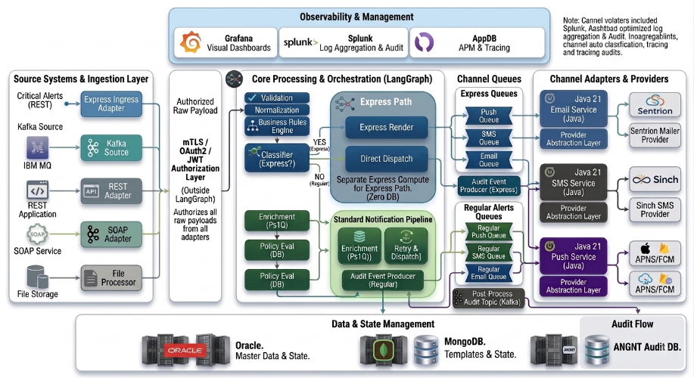
System Architecture

Slide 8
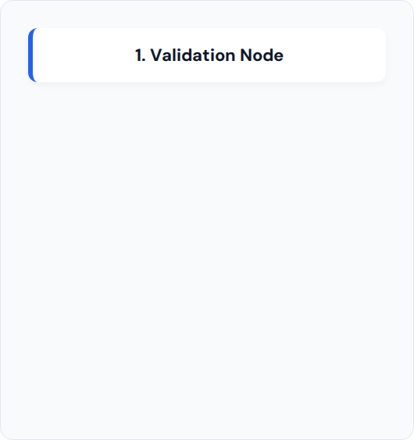



Core Processing & Orchestration
LangGraph-Based Rules Engine
↓
The LangGraph layer serves as the central brain of the platform. It executes critical business logic as a discrete graph of nodes before dynamically routing the payload.
↓
Ensures canonical normalization.
↓
Executes pre-dispatch validations.
Intelligently classifies traffic urgency.

Slide 9
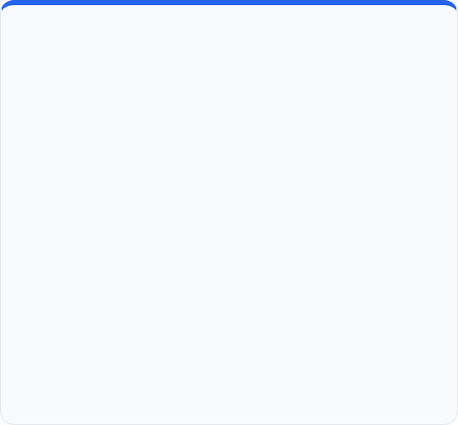
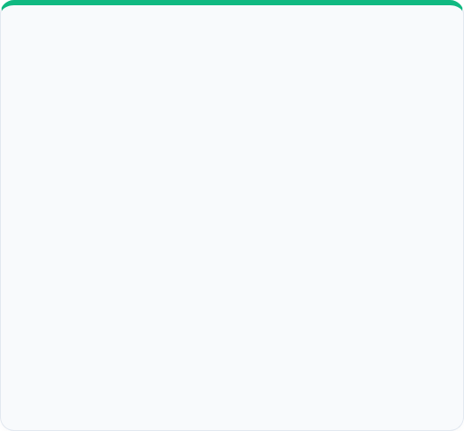
Pipeline Bifurcation
Express Path (Zero-DB)
Standard Pipeline
•
Dedicated processing compute exclusively for critical alerts.
•
Handles all regular and bulk notification traffic routing.
•
Strict Zero-DB interaction policy to eliminate latency.
•
Content template fetching integrated securely via MongoDB.
•
Fetches template details directly from in-memory cache.
•
Executes context enrichment via Oracle Master Data.
•
Utilizes a Direct Channel Dispatcher for immediate delivery.
•
Features built-in AI retry mechanisms and fallback channels.

Slide 10







Channel Adapters & Providers
Email Service
SMS Service
Push Service
Java 21 Worker dedicated to secure, high-volume email delivery via the Sentrion Mailer Provider.
Standardized SMS abstraction layer connected seamlessly to the Sinch provider network.
Unified Push Service dynamically routing device tokens to Apple (APNs) and Firebase (FCM) ecosystems.

Slide 11



Data & State Management
Master Data
Template Store
Enterprise Oracle infrastructure securely handles core relational data, transactional state tracking, and complex user profiles.
High-speed MongoDB NoSQL document store utilized by the Standard Pipeline for rich template fetching and state caching.

Slide 12

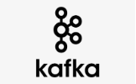
Audit Flow & Integrity
ANGNT
Event Streaming
Audit Database
Every request posts structured audit data to a dedicated Kafka Post-Process Topic via the Audit Event Producers.
The Audit Service consumes the Kafka topic and seamlessly aggregates all historical request data into the highly compliant ANGNT DB.

Slide 13

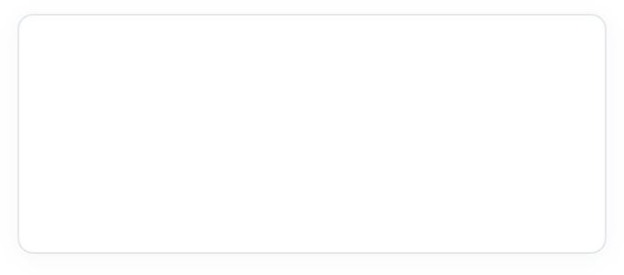





Key Takeaways
The hardest part wasn’t handling 20M alerts. It was handling everything that happens before the alert is sent.
01 — MODEL THE REAL WORLD
Model the real world
Identity and eligibility are part of the workflow.
02 — ORCHESTRATE, DON'T JUST AUTOMATE
Orchestrate, don’t just automate
The system needs to decide what happens next.
LANGGRAPH
ORCHESTRATION
03 — DESIGN FOR CHANGE
Design for change
New business rules should become new paths, not rewrites.
04 — MAKE EVERY DECISION VISIBLE
Make every decision visible
If you can’t see the journey, you can’t improve it.
MESSAGE DELIVERY ➔ DECISION ORCHESTRATION
“The future of alerting isn’t just bigger pipelines. It’s smarter workflows.”

Slide 14
Thank You
Notification System Architecture

